Slide 1


Lukas Wallrich (lukas.wallrich@ stmarys.ac.uk) October 2020 .
PSY4013 – Intro to Social Psychology
4: Altruism and attraction
A: Self-interest and altruism
Notes:
Lecture split into multiple parts, with small review questions in between – this first part is the heaviest

Slide 2
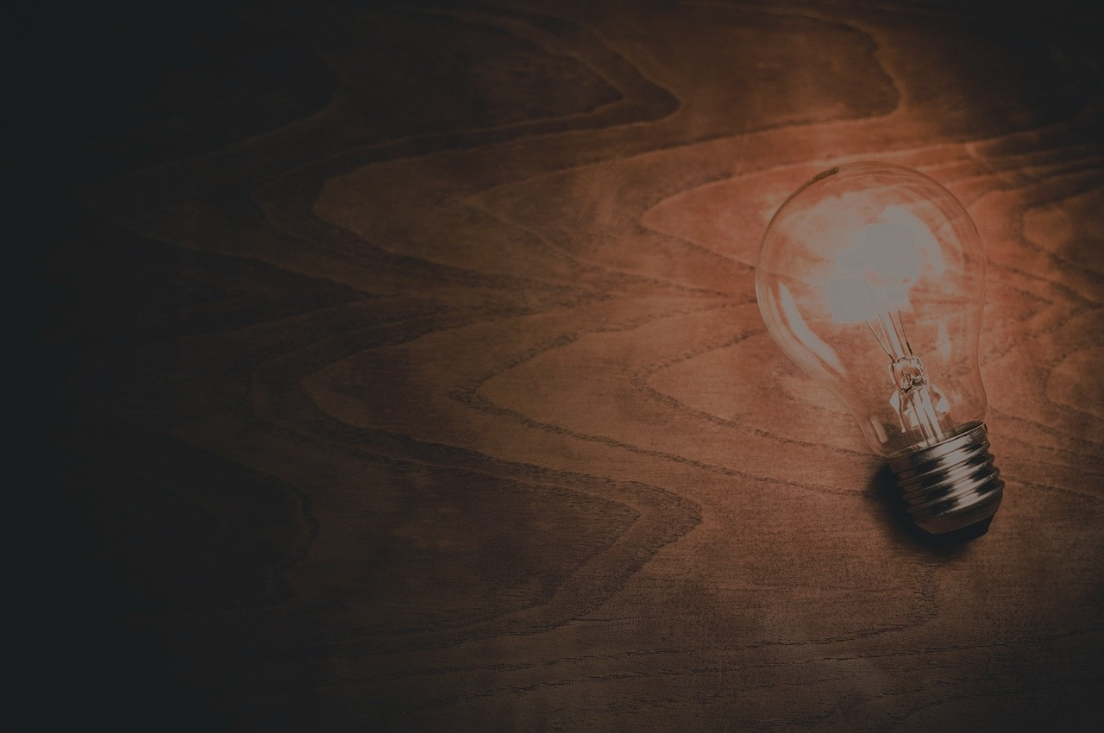
Are people generally more interested in their self-interest than in those of others?
What predicts pro-social behaviour?

Slide 3
Prosocial behavior
Action intended to benefit another
Can be done to gain either external or internal reward
Benevolence
Action intended to benefit another, but not to gain external reward
Pure altruism
Action intended to solely benefit another
No external reward to the helper
No internal reward to the helper
Some argue there is no such thing as pure altruism
Would good people ever get no internal reward?
For present purposes: altruistic actions are those that are largely motivated by benefit to another

Slide 4
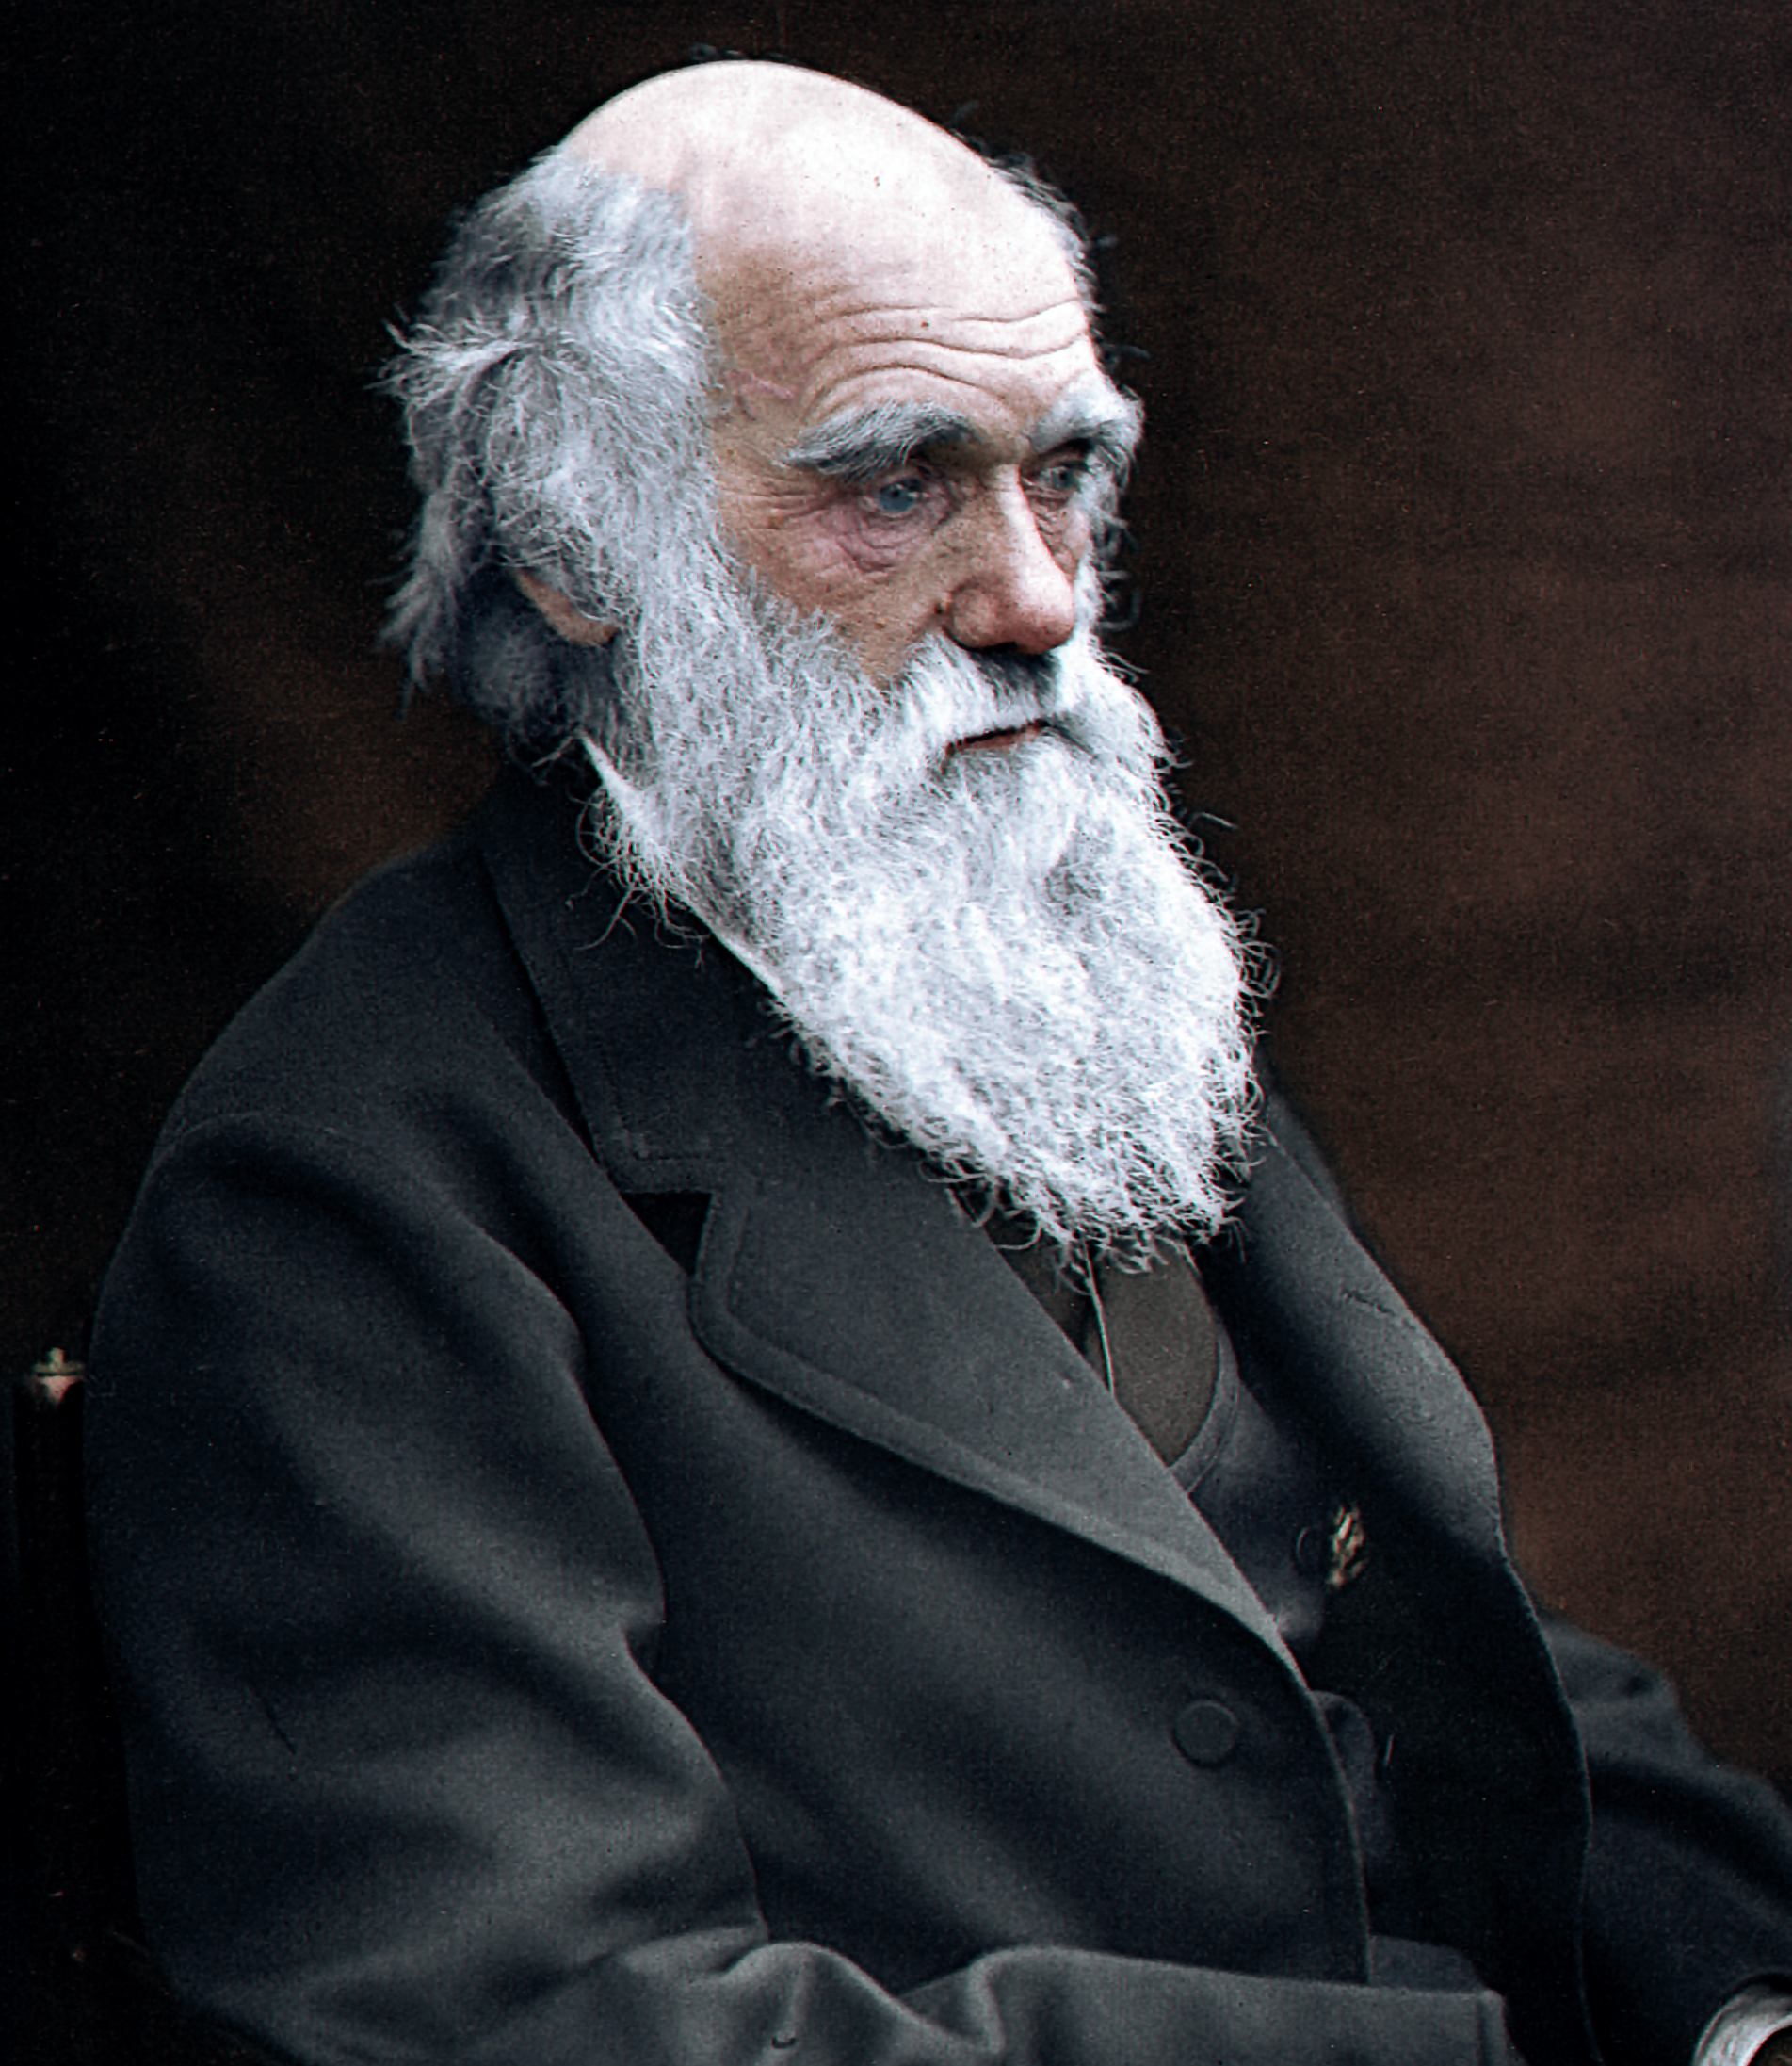
Darwinian “dilemma”
Claim: Altruistic behavior may decrease chances for reproduction/passing on of genes
How can prosocial behavior be explained evolutionarily without contradicting Darwin’s theory of the “survival of the fittest”?

Slide 5
Let’s stop misunderstanding Darwin
“Sympathy will have been increased through natural selection for those communities which included the greatest number of the most sympathetic members would flourish the best and raise the greatest number of offspring.”
- <The Descent of Man> Charles Darwin, 1871
Notes:
Darwin did not talk about “survival of the fittest” – that was a wording developed by an economist

Slide 6
Theories of Prosocial Behavior: Possible explanations for why we help
Evolutionary
Help those close to us
Establish norms of reciprocity
Social exchange
Helping has costs and benefits
Both external and internal
Help when benefits outweigh costs
Empathy-altruism
Empathy allows us to take perspective
Want to reduce other’s distress
All predict/explain in-group bias

Slide 7
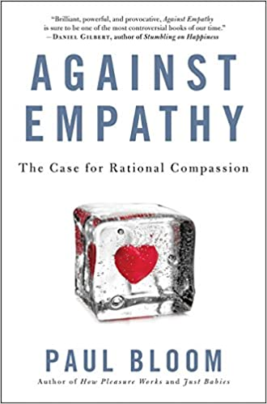
“[Empathy] is innumerate, favouring the one over the many”

Slide 8
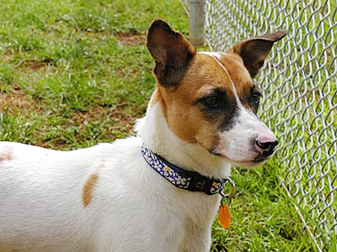
Helping, affect and cognition
Identified victims are helped more than statistical victims
Hokget, saved at sea, $US 48,000 donated

Slide 9
Helping, affect and cognition
Cognitive explanation: need a reference group to assess impact. Saving 10 people in a village matters more than 10 people in the world – and identified victims are their reference group (proportion dominance)
Affective explanation: engaging with individual causes greater distress – one study showed that single identified victim supported more than multiple identified victims (and non-identified)
Group-identity explanation: effect strongest when victim is dissimilar to donor – so identifiability humanises victim

Slide 10
Compassion fade
Larger groups of people in need often trigger smaller donations
Appears to contradict morals and logic
Contradicts people’s own predictions
Scope insensitivity (innumeracy)
People’s willingness to save birds did not differ between 2,000 and 200,000 birds (Devousges et al., 1993)
Intervention: unit asking.

Slide 11
Bystander behaviour
Helping a stranger in distress
Shocking stories / studies:
Kitty Genovese: young woman murdered in New York while neighbours just watched (1964)
Not how it went!
Good Samaritan study in seminary (Darley & Batson, 1973)

Slide 12
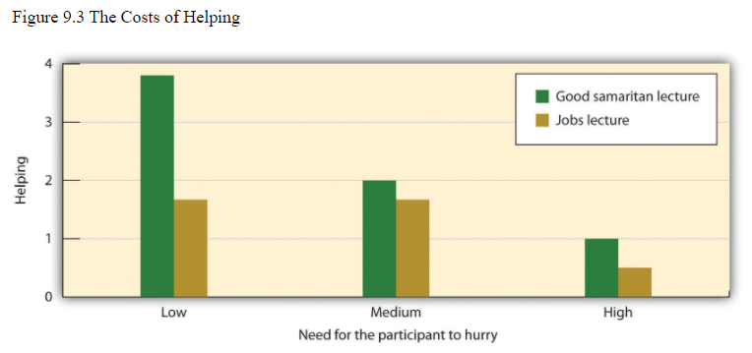
Good Samaritan study (Darley & Batson, 1973)
Participants in a hurry rarely helped – even when rushing to talk about the Good Samaritan
Lecture topic made no difference - based on null-hypothesis significance testing

Slide 13
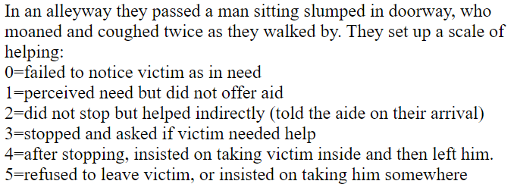
Research methods: averaging across behaviours?

Slide 14
Problem with significance testing
Test whether we can be quite sure of an effect by asking how unlikely our observation would have been under null-hypothesis
Not being sure does not mean that there is no effect! (Here, the sample was too small!)
Bayesian analysis allows to judge probabilities of different beliefs – Greenwald (1975) suggests odds of 5:1 for effect of Good Samaritan story

Slide 15
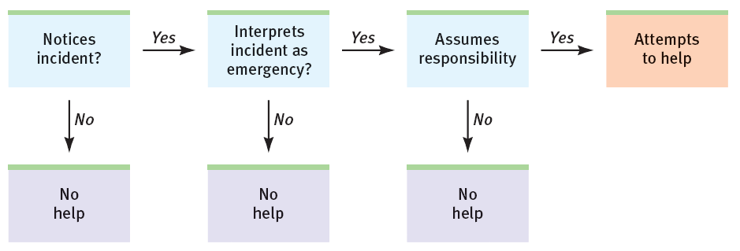
Steps towards bystander intervention
Attention:
Appraisal:
Social Role:
Taking Action:

Slide 16
Bystander effect
Sometimes, fewer people help when more are available
Why?
Diffusion of responsibility (free-riding)
Conformity
Informational influence & pluralistic ignorance
Bystander effect reduced when situations were physically dangerous (Fischer et al., 2011)

Slide 17
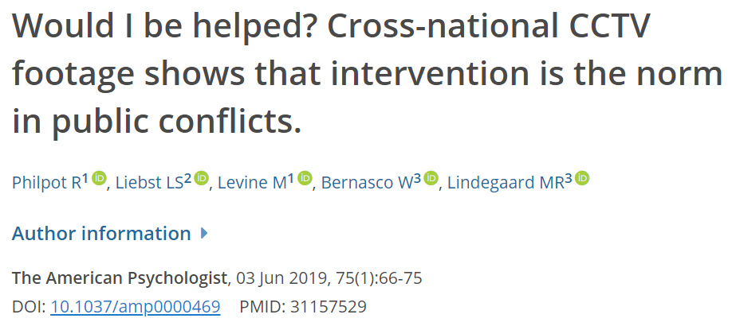
→ Bystanders intervened in 90% of conflicts
→ More bystanders: more help

Slide 18
Reciprocity and social norms
Can emphasize social norms and social identities
Developmental psychology: raising “helpers”
Choosing the stories we tell
Setting expectations – duty-to-rescue laws, e.g., in Germany and Spain
Can start chains by “paying it forward”
Organised example: donating a kidney

Slide 19
Psychological benefits of helping
Helping increases:
Self-worth (Schwartz et al., 2009)
Well-being (Curry et al, 2018)
Longevity (Brown et al., 2003)
Reputation & prestige (Hardy & van Vugt, 2006)
Loving-kindness meditation uses this in therapeutic context – try it out for yourself

Slide 20

Lukas Wallrich (lukas.wallrich@ stmarys.ac.uk) October 2020 .
PSY4013 – Intro to Social Psychology
4: Altruism and attraction
B: Predictors of liking and attraction
Notes:
Lecture split into multiple parts, with small review questions in between – this first part is the heaviest

Slide 21
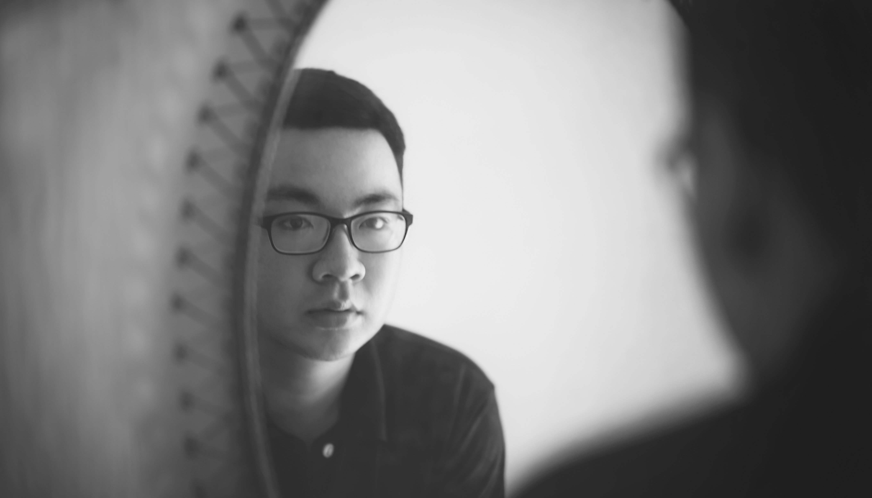
Mirrors versus photos
Mita, Dermer & Knight (1977) gave participants normal pictures and mirrored pictures
Participants, friends and lovers asked about preference

Slide 22
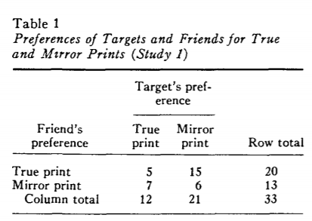
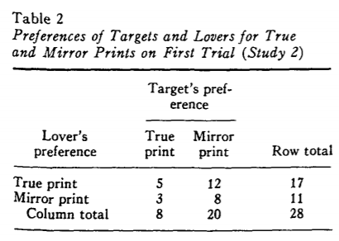
Mirrors versus photos

Slide 23
Moreland & Beach (1992)
Confederate sits in front row of class for 0 to 15 weeks, at end of course, students rate confederate

Slide 24
Mere exposure
Neutral stimuli are judged more positively after repeated exposure (Robert Zajonc, 1968)
Intervention: exposure to pictures of other ethnic groups can reduce prejudice (Zebrowitz, White & Wieneke, 2008)

Slide 25
Reciprocity (Curtis & Miller, 1986)
Randomly pair participants
Tell one participant (P) that their partner (T) either does or does not like them
P and T interact, and post-interaction liking is measured

Slide 26
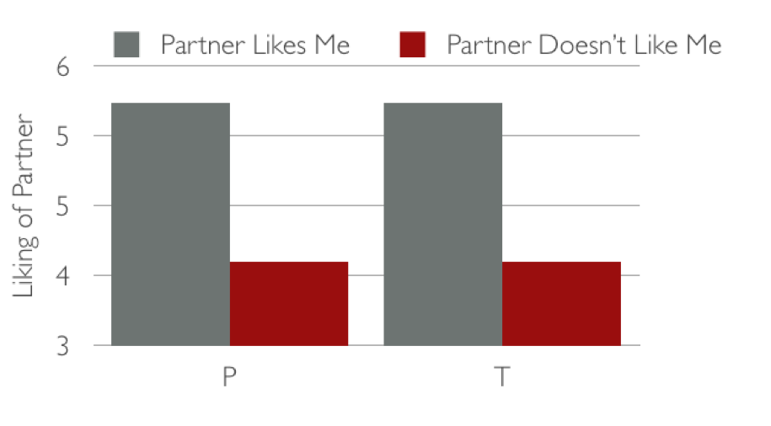
Reciprocity
P was told:
T
T
Two (complementary) explanations:
P likes T: We like those who like us.
T likes P: “Behaviors make beliefs come true”

Slide 27
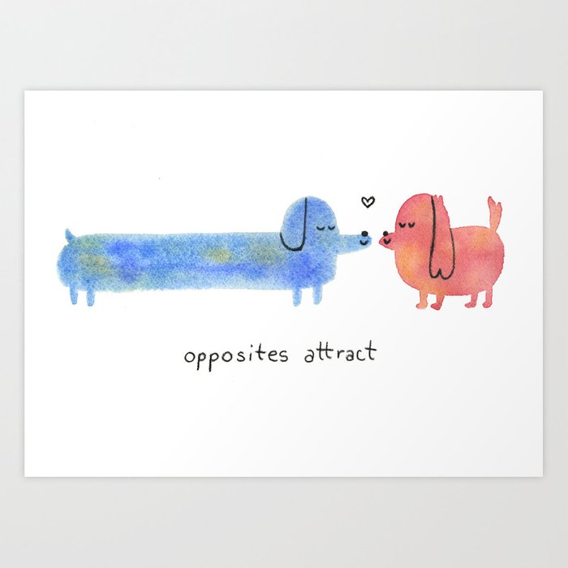

Checking intuitions

Slide 28
Similarity matters
Newcomb (1961): similarity in attitudes and beliefs a key factor for forming friendships (N = 17!)
Also true for similar personalities among chimpanzees (Massen & Koski, 2014)
In analyses of friendship networks, strong appearance of homophily in terms of gender, ethnicity and social class (McPherson et al., 2001)
Notes:
Who is sitting next to you?
“Cafeteria effect” – social segregation – is very widespread

Slide 29

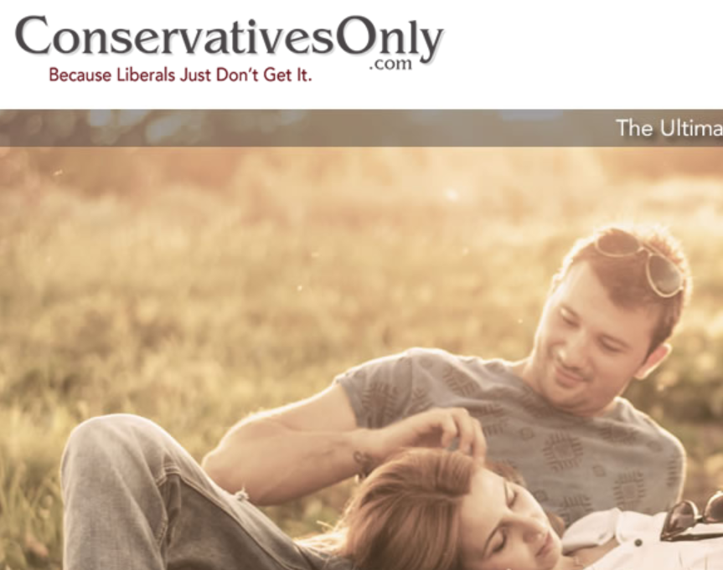
Similarity as a selling point
“Find partners, friends and soulmates who think like you”
“Stop wasting time with undesirables”
Notes:
Even Bumble now has election day filters

Slide 30
Ethnic biases: preferences in online dating
Mendelson et al. (2014) studied more than 1 million users of an US online dating page
Could set preferences for ethnic groups to date – default: any
Among White users:
60% changed that default to exclude some groups
32% (50% of women) said “Whites only”
Among Black users:
54% changed away from any
19% (36% of women) said “Blacks only”

Slide 31
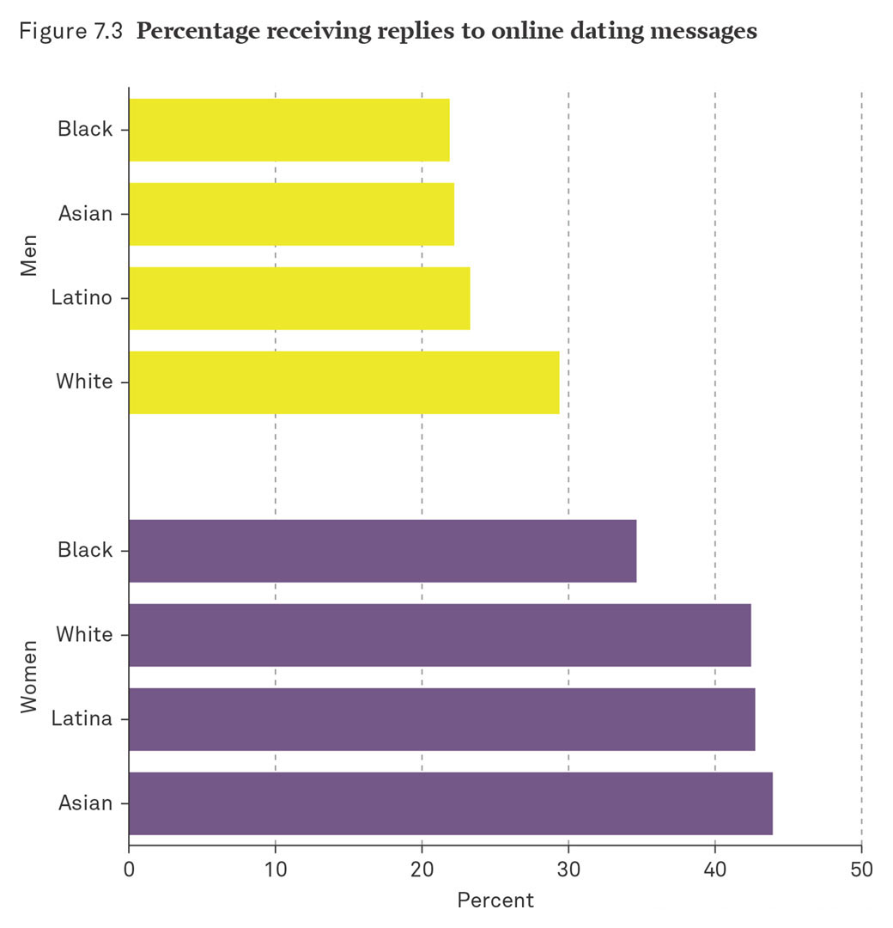
Ethnic biases: Percentage Receiving Replies to Online Dating Messages
Notes:
This figure show the percentage of individuals (broken down by gender and race) receiving replies to online dating messages.
OK Cupid surveyed a half-million randomly selected site users and found the following.
White men were more likely than other men to receive a reply from a woman.
Black women were the least likely to receive a reply.
This seems to reinforce data from other researchers that asserts the fact that racial/ethnic boundaries remain an issue both off- and online.
Source: Cohen’s graph from OK Cupid research (Rudder, 2009).

Slide 32
Result: Endogamy
In US, 1.5% of all co-habituating young couples are Black/White (with equal chances, would expect about 7%), with most being a Black man and White woman (Torche & Rich, 2017)
Why?
Homophily: liking of those who are similar?
Negative racial attitudes?
Contact opportunities?
Status exchange hypothesis: reduction in racial status needs to be compensated for by, e.g., higher education

Slide 33
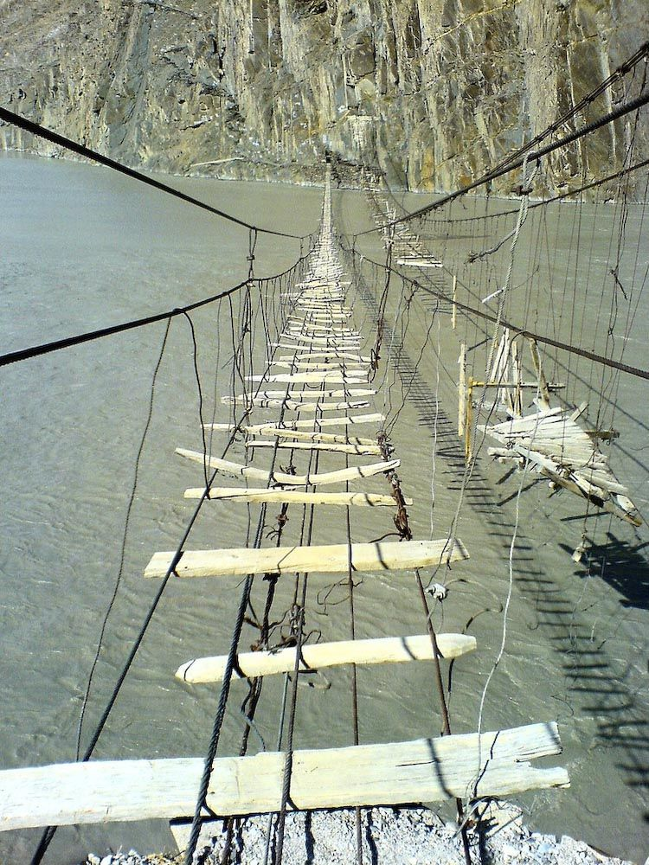
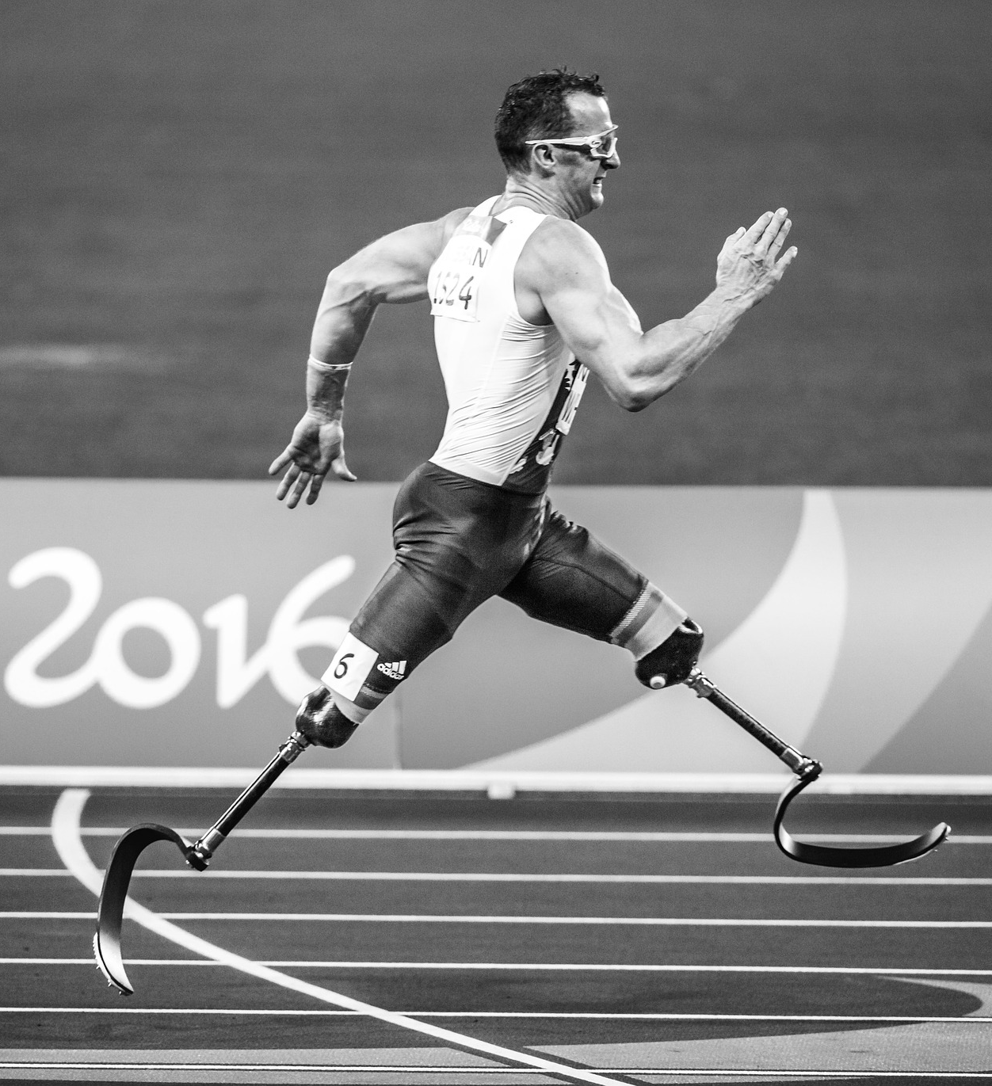
Attraction (perceived beauty)
Attraction partly indicated by physical arousal
Sources of physical arousal not directly perceived
Opportunity for misattribution

Slide 34
Lukas Wallrich (lukas.wallrich@ stmarys.ac.uk) October 2020 .
PSY4013 – Intro to Social Psychology
4: Altruism and attraction
C: Beauty – myths and debates
Notes:
Lecture split into multiple parts, with small review questions in between – this first part is the heaviest

Slide 35
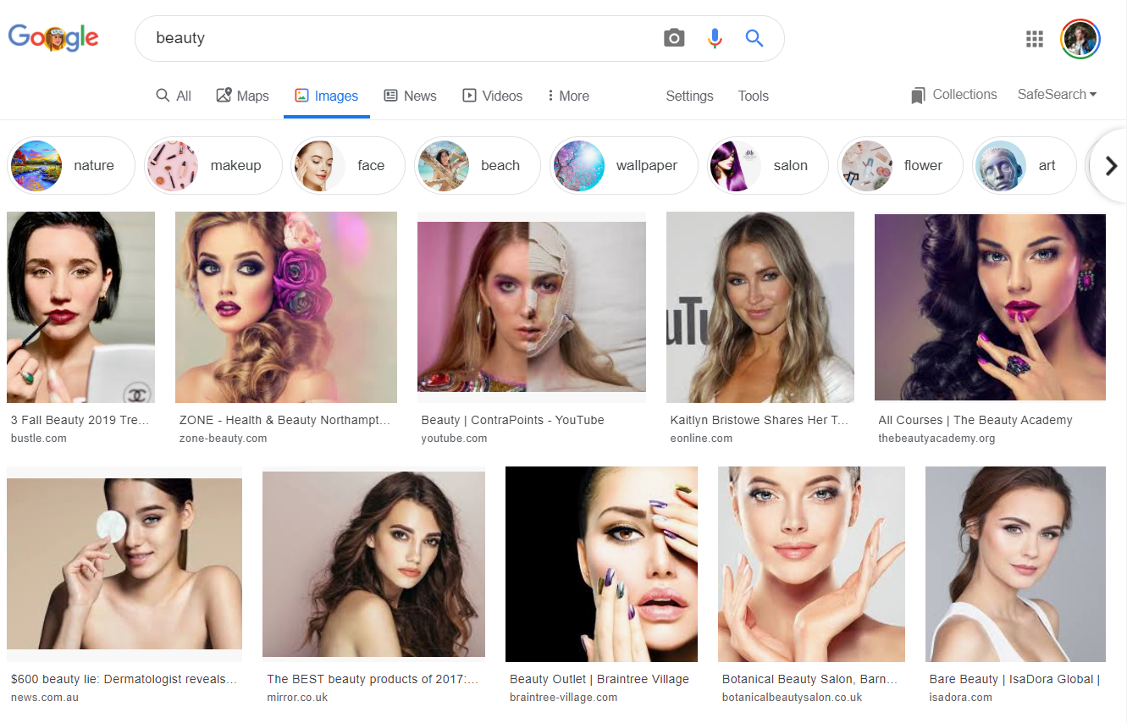
Beauty 2019

Slide 36
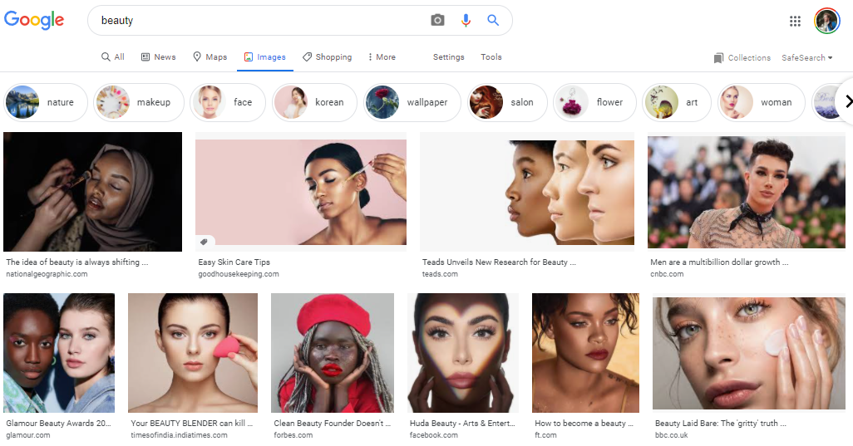
Beauty 2020

Slide 37
Maxims and myths of beauty (Langlois et al., 2000)
Myth: “Beauty is in the eye of the beholder.”
Raters agree about who is and who is not attractive
Myth: “Never judge a book by its cover.”
Attractive children and adults are judged more positively, even by those who know them
Attractive children and adults are treated more positively, even by those who know them
Myth: “Beauty is only skin-deep.”
Attractive children and adults exhibit more positive behaviors and traits
Notes:
Infants already show preference for attractive dolls and attractive faces (https://psycnet.apa.org/record/1990-12033-001)

Slide 38
Cultural differences and similarities
Standards differ from culture to culture about what facial and body features are desirable.
Across cultures (suggesting evolutionary influence):
Men seek apparent youth and fertility
Women seek maturity, masculinity, affluence
Both like facial symmetry and averageness
Also attractive: Nice people, and loved ones.
Experiences (e.g., violence) can shift attraction

Slide 39
Beautiful-is-Good: Stereotype
Tendency to associate attractiveness with “goodness”
“Goodness” varies between cultures
Stereotypes across cultures (see Wheeler & Kim, 1997)
Traits in US, Canada, & Korea | Traits only in US & Canada | Traits only in Korea
Sociable/likeable Friendly/popular Well-adjusted & mature Happy Intelligent | Strong Dominant Assertive | Sensitive Generous Warm Trustworthy/honest Empathic

Slide 40
Beautiful-is-Good: Fact (?)
Attractive adults have greater occupational success, social skills, self-esteem, (slightly) intelligence (Langlois et al., 2000)
Why?
Mothers already give more affectionate care to attractive infants (Langlois et al., 1995)
Self-fulfilling trend from there?

Slide 41
Why does beauty matter?
Evolutionary perspective: signals health and fertility
But: ideals changes over time
Explanations naturalize status quo
Social perspective: signals resources and commitment
Critical perspective: promotes and signals submission
Notes:
Evolutionary perspective: https://www.ncbi.nlm.nih.gov/pmc/articles/PMC3130383/#s2title

Slide 42
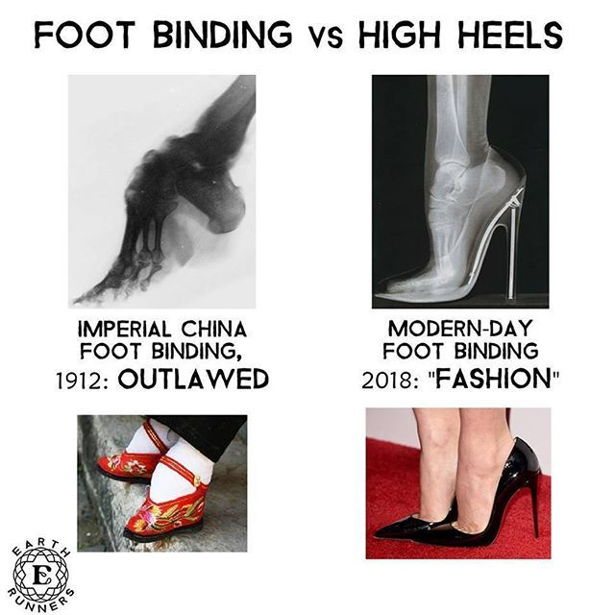

Slide 43
Responses to scarcity: Closing time studies
Pennebaker et al., 1979, then Johnco, Wheeler & Taylor, 2010:
Approached people in bars
People asked to judge attractiveness of same-sex and opposite-sex targets (both photos and other patrons)
Time until closing time used as independent variable
Statistically controlled for alcohol intake
Notes:
Worth reading the original article – very well written.

Slide 44
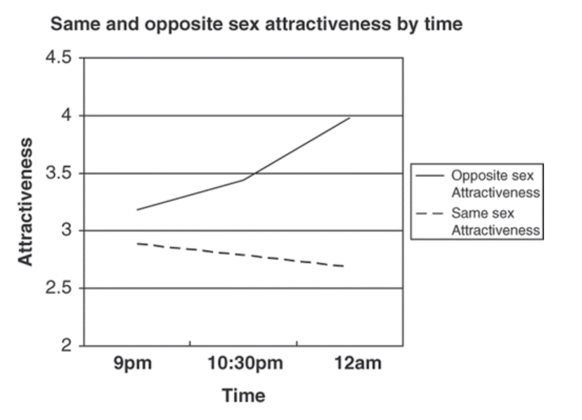
So, do “the girls get prettier by closing time?”
Notes:
Holds when controlling for alcohol

Slide 45
Lukas Wallrich (lukas.wallrich@ stmarys.ac.uk) October 2020 .
PSY4013 – Intro to Social Psychology
4: Altruism and attraction
D: Maintaining close relationships
Notes:
Lecture split into multiple parts, with small review questions in between – this first part is the heaviest

Slide 46
Lending a hand (Coan, Schaefer & Davidson, 2006)
Participants were presented with threats that sometimes lead to an electric shock → stress
Either alone, or holding spouse’s hand, or stranger’s hand
Rated unpleasantness and arousal
Notes:
Close marriages: stronger effect
Article focuses on effect on various brain regions – worth having a look if interested in neuropsychology

Slide 47
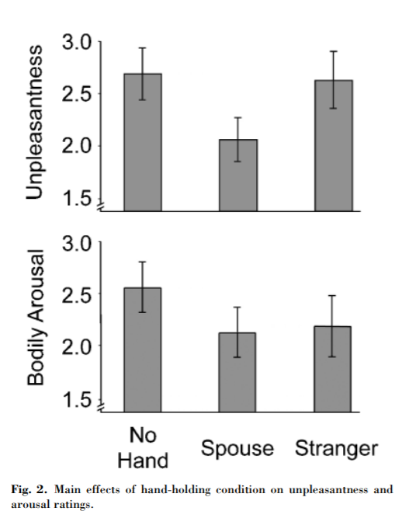
Lending a hand (Coan, Schaefer & Davidson, 2006)
Notes:
Close marriages: stronger effect
Article focuses on effect on various brain regions – worth having a look if interested in neuropsychology

Slide 48
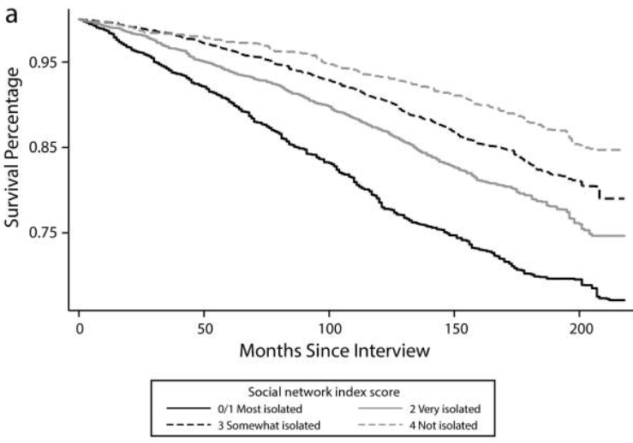
Social isolation predicts mortality (Pantell et al., 2013)
Study of more than 16,000 adults
Notes:
This shows women – effect for men slightly smaller
Social isolation: marriage, friends, clubs, religious groups

Slide 49
Social isolation predicts mortality (Pantell et al., 2013)
Study of more than 16,000 adults
Overall, impact of social isolation comparable to smoking
Being unmarried comparable to obesity, high blood pressure and high cholesterol
But: correlation is not causation

Slide 50
Triangular theory of love
Held together by positive interaction, support
Grows into Compassionate Love
Then often has a phase of Passionate Love
Made closer by Equity and Self-Disclosure
Often starts with attraction, or friendship
From: Myers – Exploring Psychology

Slide 51
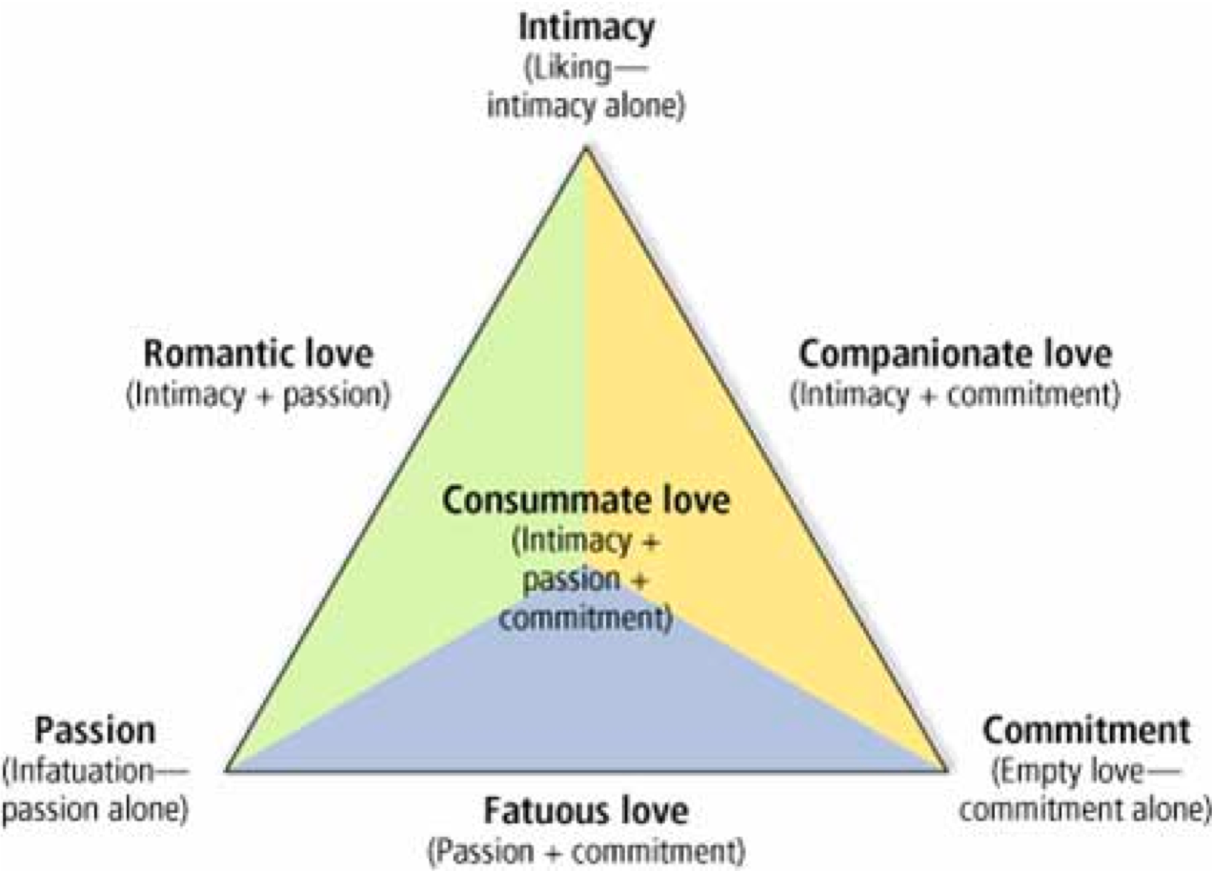
Triangular theory of love

Slide 52
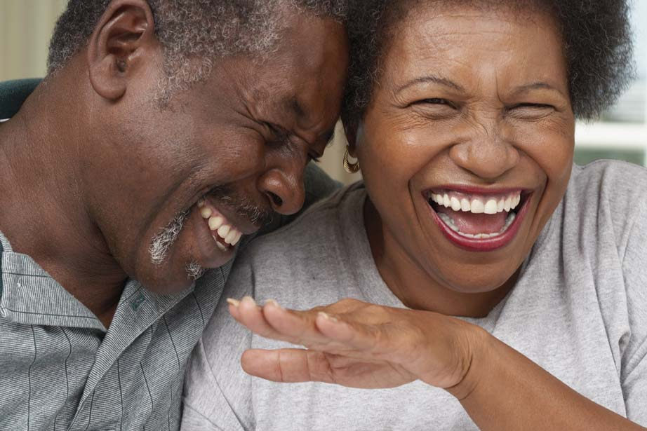
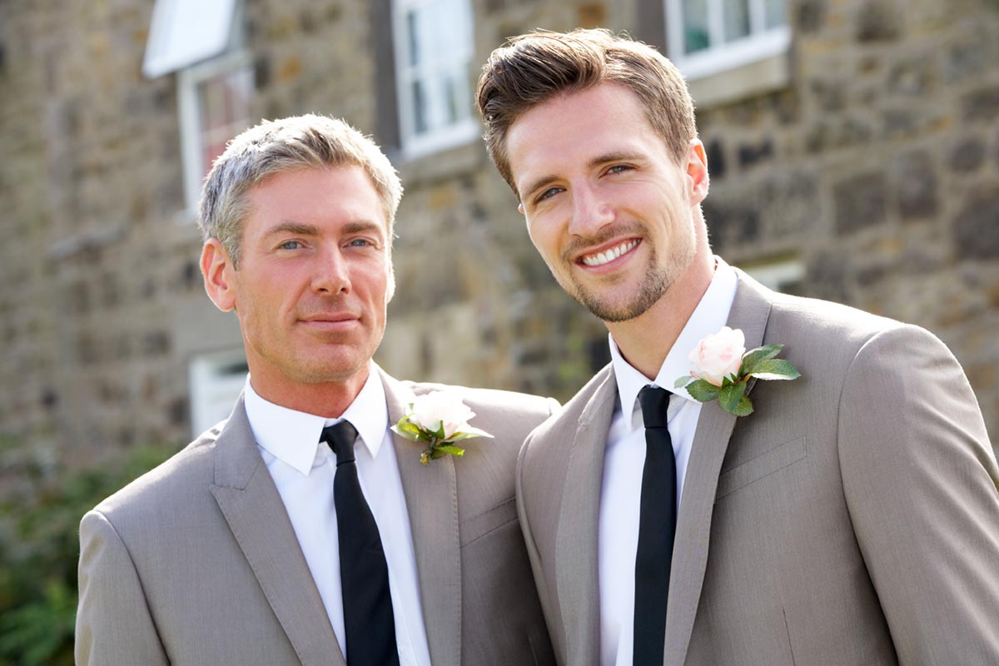
Keys to a lasting love relationship
Equity: Both giving and receiving, sharing responsibilities, with a sense of partnership
Self-Disclosure: Sharing self in conversation increases intimacy
Positive Interactions and Support: Offering sympathy, concern, laughs, hugs
Benevolent attributions: positive behaviours to character, negative behaviours to circumstances

Slide 53
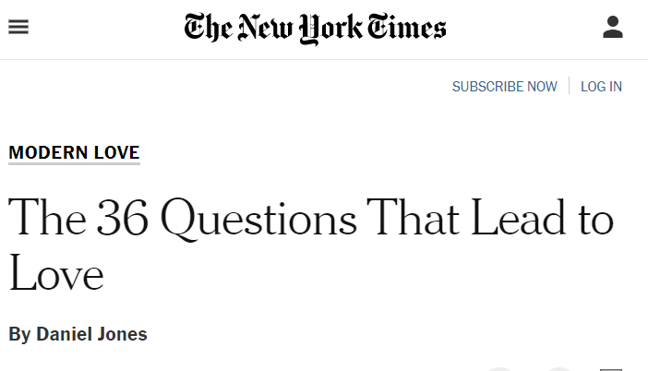
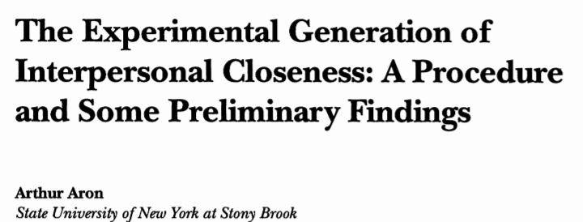
Can psychologists create love?

Slide 54
Some take-aways from today
Prosocial behaviour is widespread – can be explained through evolutionary, social exchange and emotional approaches
Compassion fade and identifiable victim effect: identifiable victim are supported more than statistical victims, and support is innumerate
Bystander effect research suggests that helping might decrease when there are many bystanders – but effect complicated and helping still the usual response
Liking based on mere exposure, similarity, reciprocity, physical attractiveness
High level of endogamy (in-group marriages) at least partly explained by homophily and negative attitudes.
Strong beautiful-is-good stereotype that is partly self-fulfilling
Close relationships (stable romantic relationships in particular) are highly beneficial to health and life satisfaction
Love can take different shapes and go through different stages – intimacy, passion and commitment are the cornerstones

